Slide 1



customer reviews
View in Power BI
Last data refresh:
8/3/2018 10:11:32 AM Romance Standard Time
Downloaded at:
12/19/2018 3:43:13 PM Romance Standard Time

Slide 2
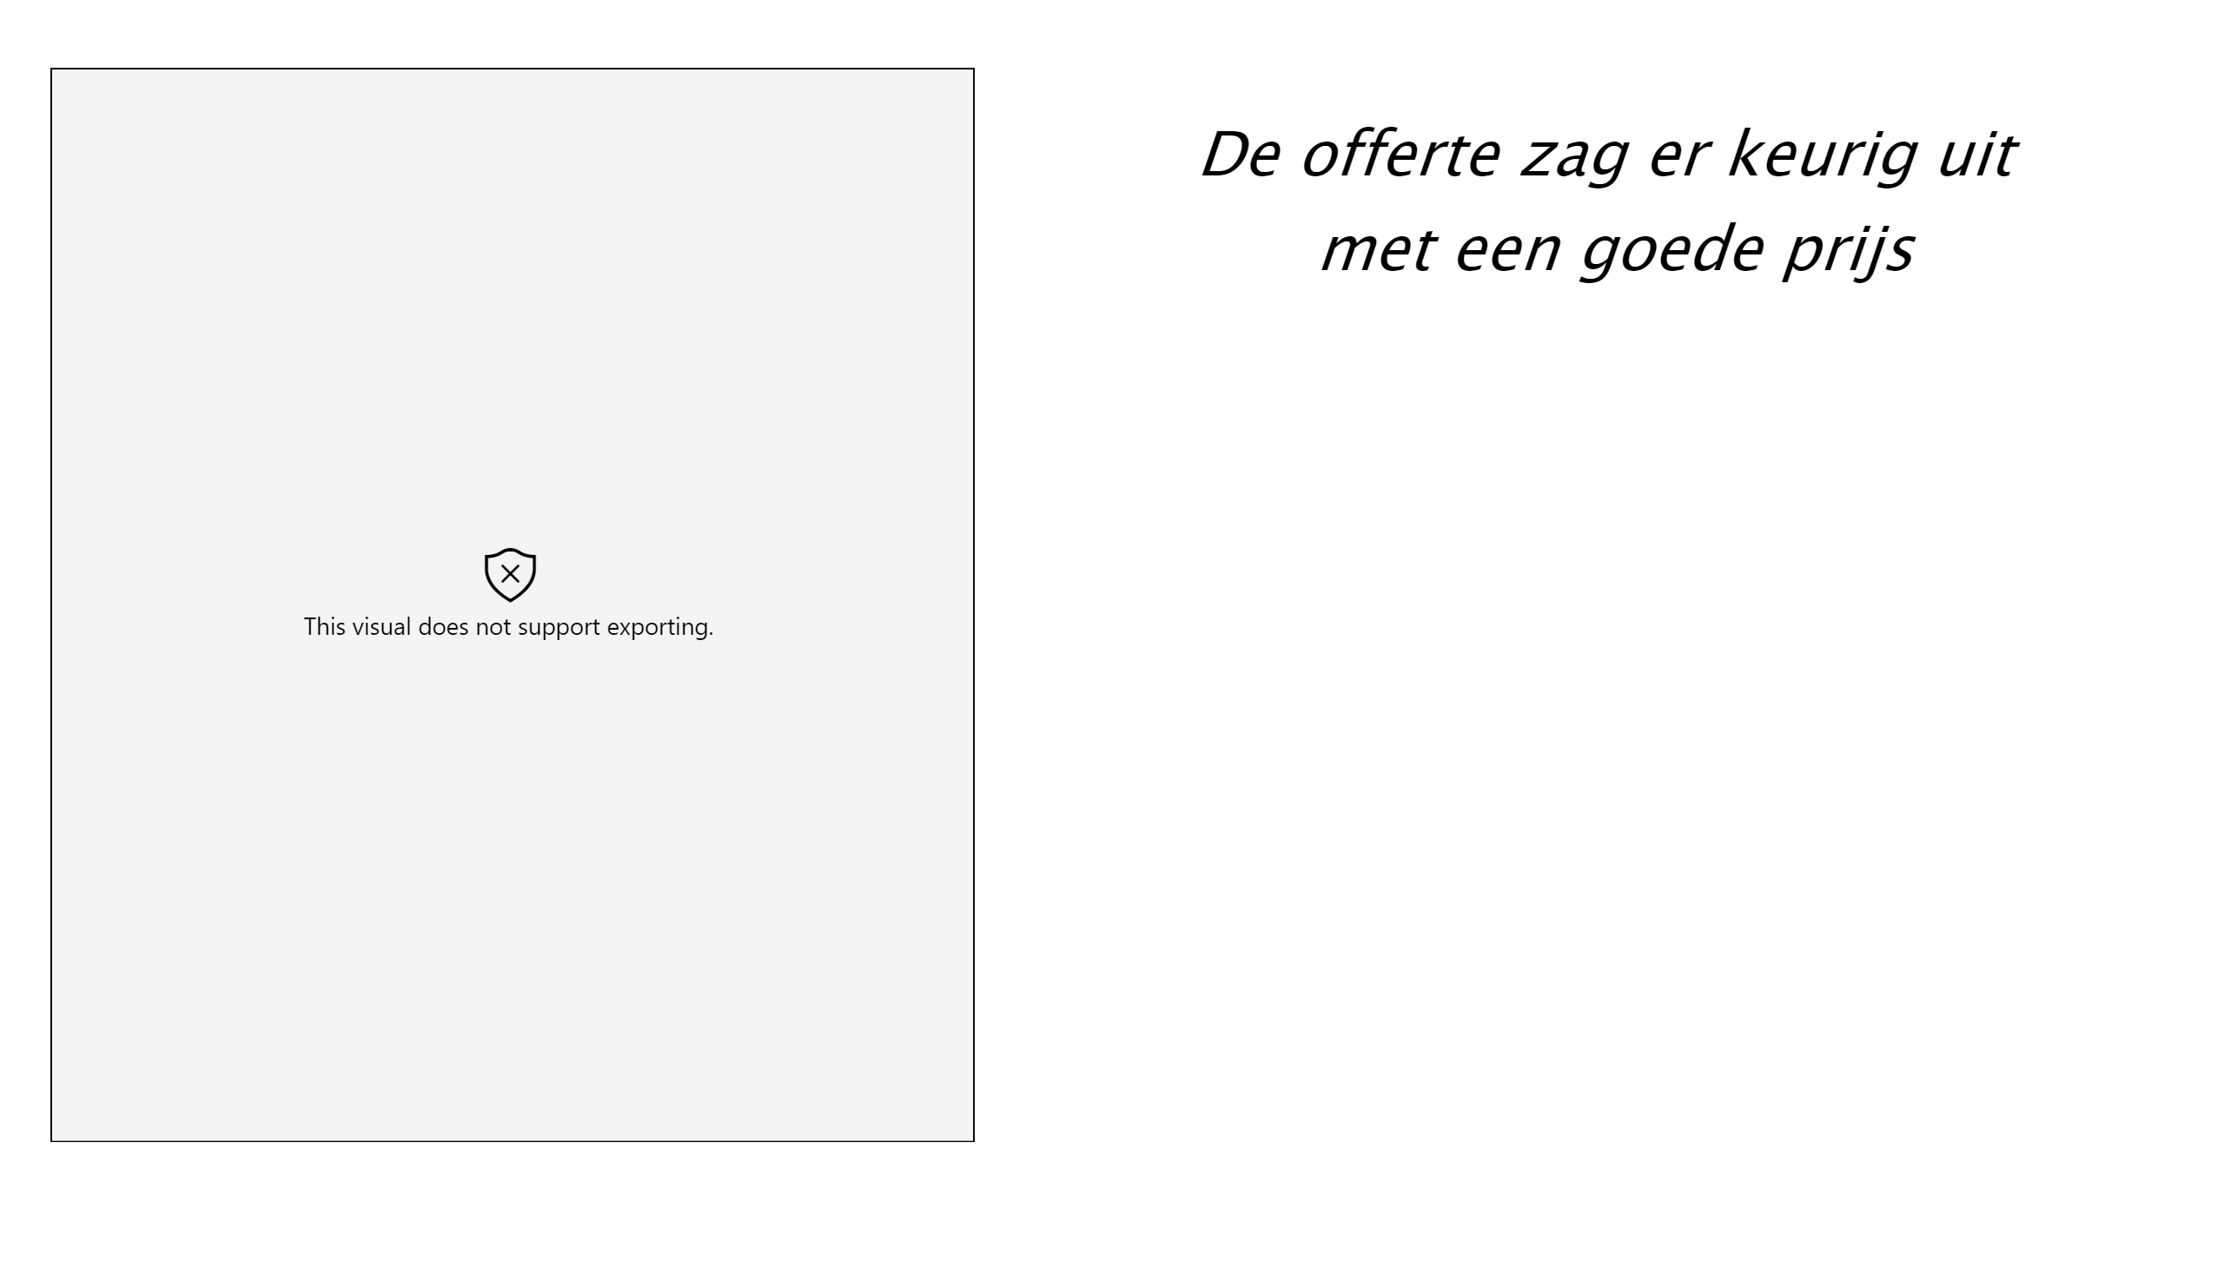

Slide 3
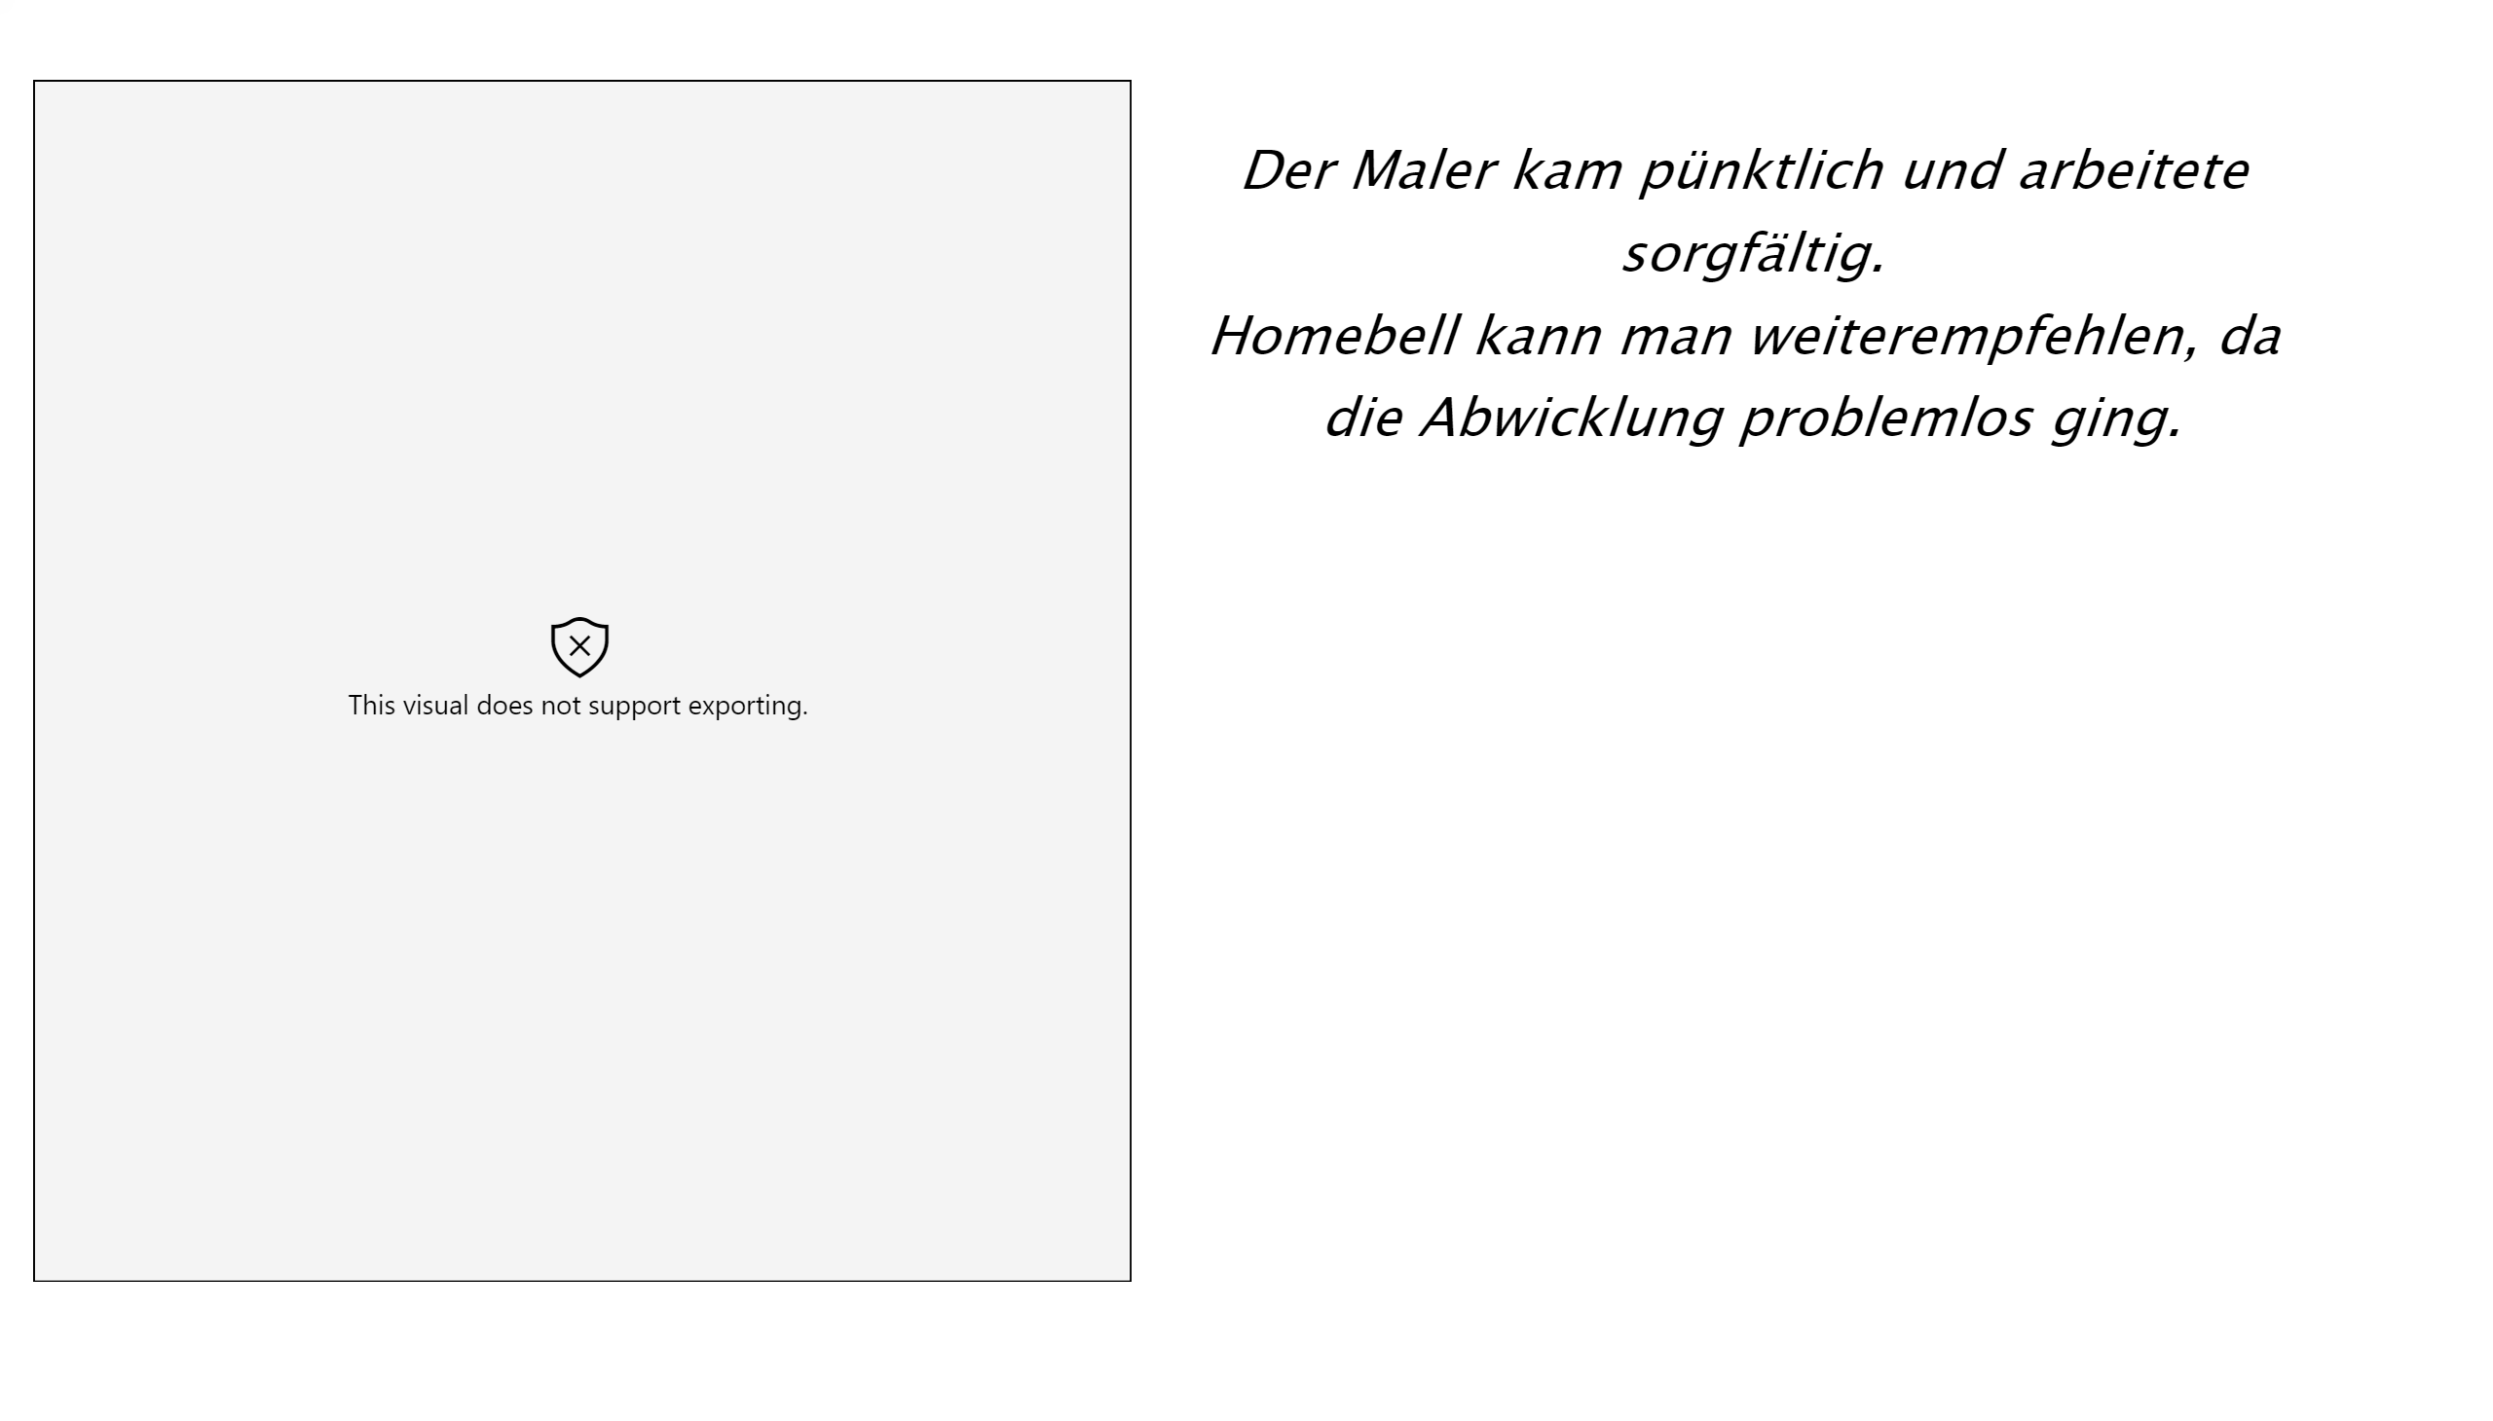

Slide 4
